Slide 1
Gym Member Manager
By
P. Sai Venunath 1602-16-737-038
K.Rohith 1602-17-737-030
Team-1(Web Devolopement)

Slide 2
Contents
Problem Statement & Motivation
Objective
Use cases
Architecture

Slide 3
Problem Statement & Motivation
Many gyms are following manual process which is hectic less accurate and time consuming
This project is to facilitate a gymming and fitness center to automate its operations of keeping records

Slide 4
Objective
A simple gym member manager to keep a track of all payments and members
Reports for keeping track of payments and admissions
The proposed system is better than existing system

Slide 5
Technology Stack
Front End:
Html
CSS
Java Script
Back End:
Django Framework
Database

Slide 6
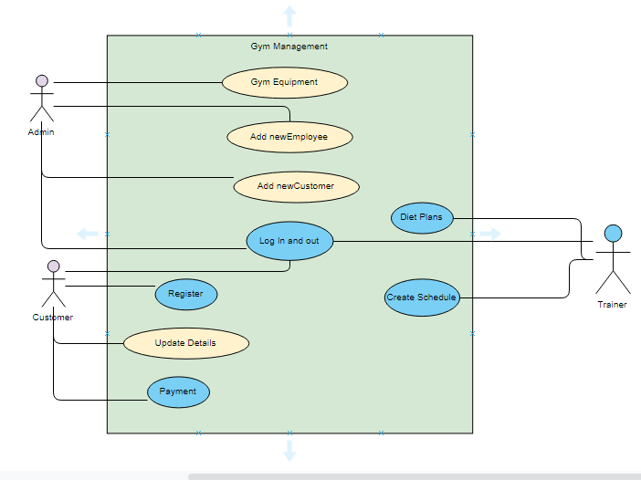
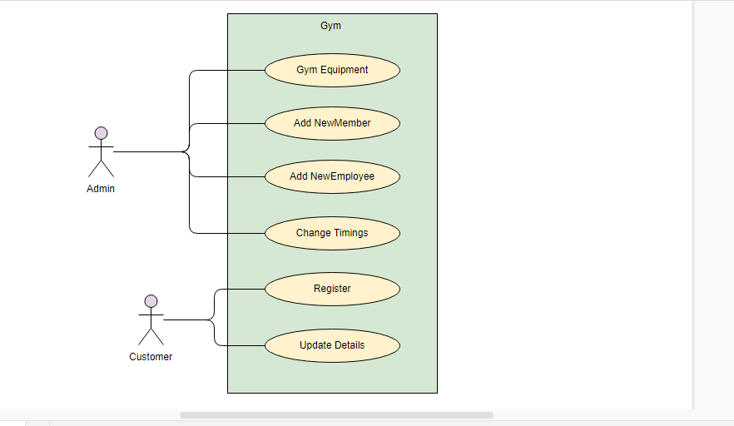
Use case

Slide 7
Thank You

